Slide 1
Computer networking
Elizabeth Michie B2

Slide 2
What is a network?
A network is when two or more computers are linked together
There are several kinds of computer networks.
LANS: Local Area Network
WANS: Wide Area Network
MAN: Metropolitan Area Network
The primary difference between the two is that a LAN is generally confined to a limited geographical area, whereas a WAN covers a large geographical area. Most WANs are made up of several connected LANs.

Slide 3
Types of networks
Local Area Network (LANS) - a network that spans a small area like a building or an office.
Wide Area Network (WANS) – A network that spans over a large geographical area
Metropolitan Area Network (MAN) – A network that spans over a city or large metropolitan area and connects businesses together
Public Access Network (PAN) –
Value Added Network (VAN) –
Virtual Private Network (VPN) -

Slide 4
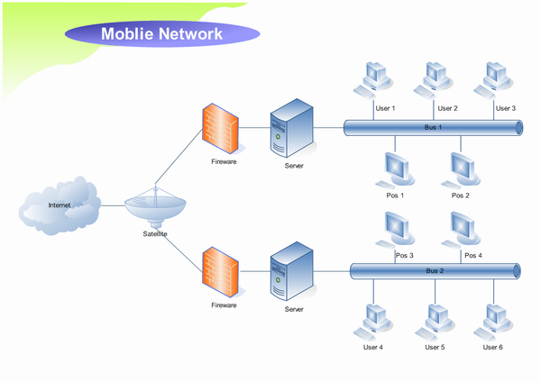
Lans
a network that spans a small area such as a building or an office.
Software applications and other resources are stored on a file server.
Print servers enable multiple users to share the same printer.

Slide 5
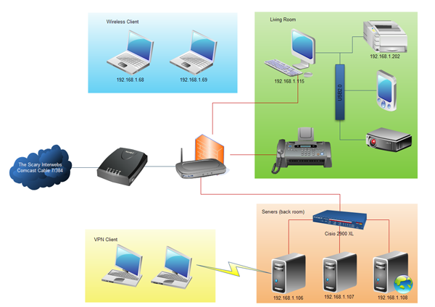
Wans
a network that spans a wide geographical area; there are several types of WANS
Metropolitan area network (MAN)
Public access network (PAN)
Value added network (VAN)
Virtual private network (VPN)

Slide 6
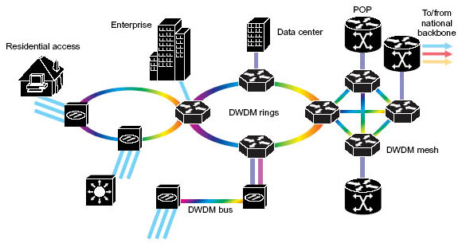
Man
A metropolitan area network is a computer network in which two or more computers or communicating devices or networks which are geographically separated but in same metropolitan city and are connected to each other are said to be connected on MAN.

Slide 7
Benefits of Network
Information Sharing – Authorized users can use other computers on the network to access and share information and data. This could include special group projects, databases, etc.
Hardware Sharing – One device connected to a network, such as a printer or scanner, can be shared by many users.
Software Sharing –Instead of purchasing and installing a software program on each computer, it can be installed on the server. All of the users can then access the program from a single location.
Collaborative Environment – Users can work together on group projects by combining the power and capabilities of diverse equipment.

Slide 8
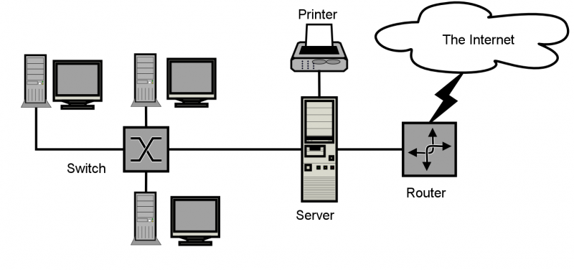
Model - LANS

Slide 9
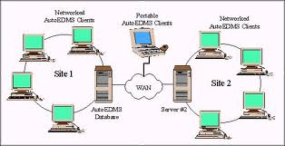
Model - WANS

Slide 10
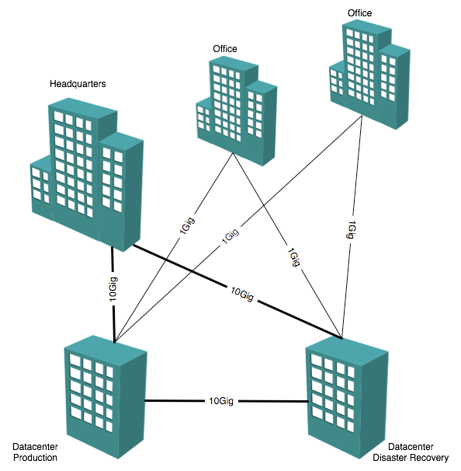
Model - MAn

Slide 11
Computer science
Computer science: the study of the principles and use of computers.
Some types of Computer Science jobs:
Software developers
Database administrators, DBAs
Computer programmers
Web Developers
Computer network architects and network engineers
Computer security and privacy/Hackers
Software application engineers

Slide 12
Computer security and privacy hackers
They help clients defeat malicious cyber attackers or data thieves.
Use computer coding
They work as consultants to law enforcement agencies, governments and businesses.
Security analysts ensure a firm’s information stays safe from cyber attacks.
The median income of computer security and privacy professional is $100,660.
A bachelors degree is needed to obtain a job in this field.

Slide 13
The End
Thanks for watching

